Slide 1
SPOTIFY DATA ANALYSIS IN BREIF STATEMENT

Slide 2
Connecting to Spotify Data
I downloaded the Spotify dataset from Zen capstone which was in csv file, then I converted to Excel work book.
Data Cleaning
I cleaned the given data, removed null values, unwanted columns and rows.

Slide 3
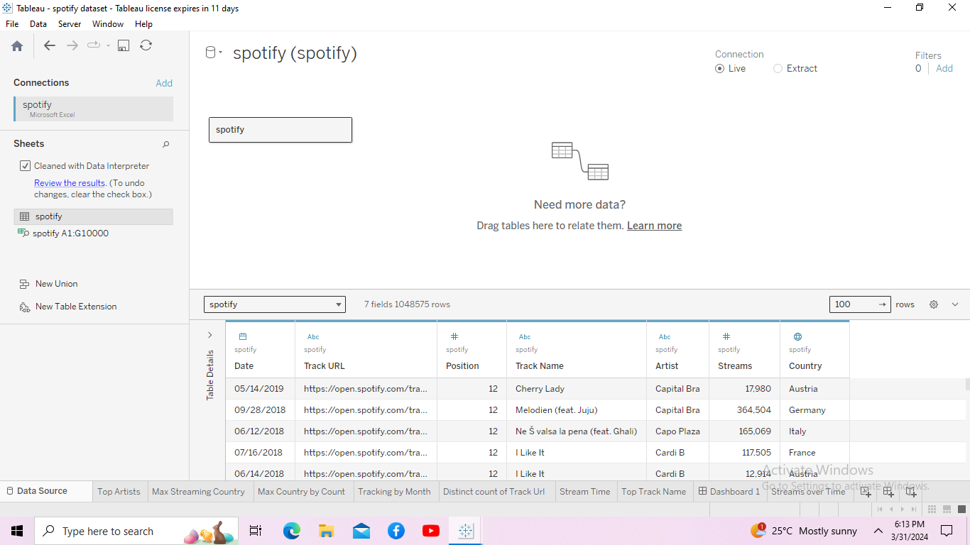
Bring it into Tableau 1. Open Tableau. In the Connect pane, select “Text file” and open the Spotify excel workbook i just downloaded. 2. Drag the Spotify Dataset onto the Canvas.

Slide 4
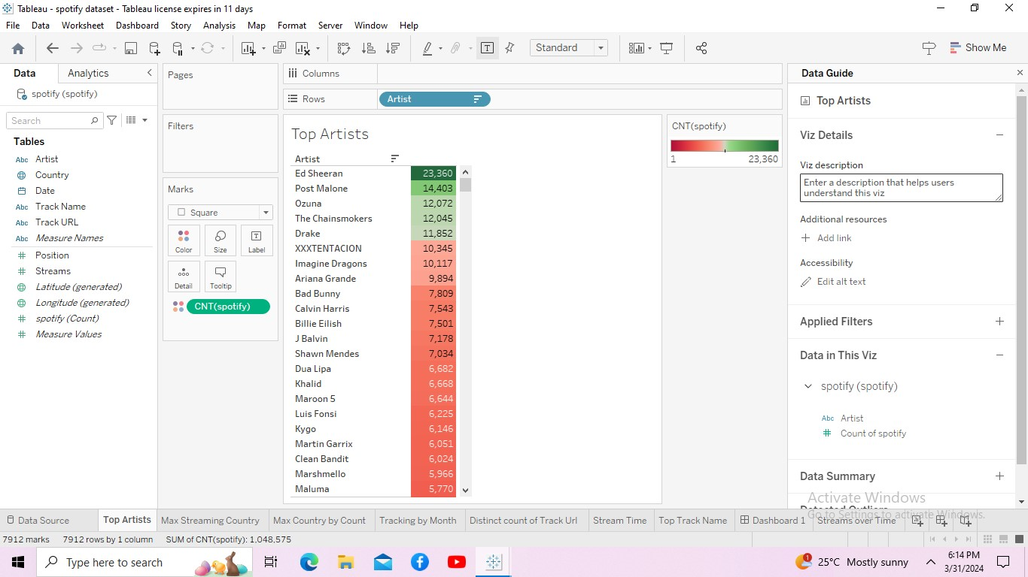
Most popular Artists By analyzing the most popular tracks in Spotify’s Top 200 list. By using the Top Artist field as a unique identifier when we’re doing distinct count of tracks since some songs may be named the same thing.

Slide 5
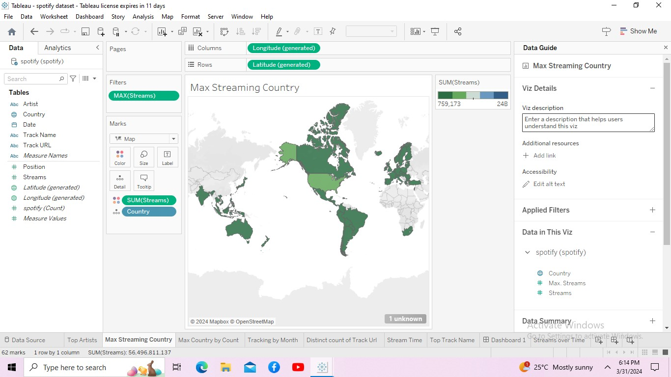
Max Song Streaming all over Country
By analyzing the most popular tracks in Spotify’s Top 200 list. By using the Streaming field in Country as a unique identifier in distinct count of streaming level all over the country, since some songs may be named the same thing.

Slide 6
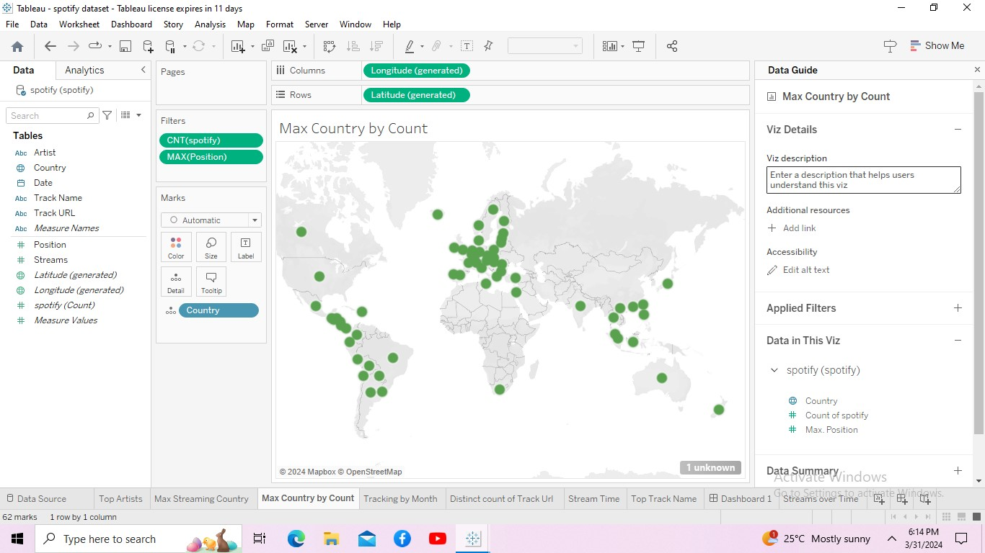
Max Country by Count In this I analyzed the most ever popular songs played maximum level in all over the country.

Slide 7
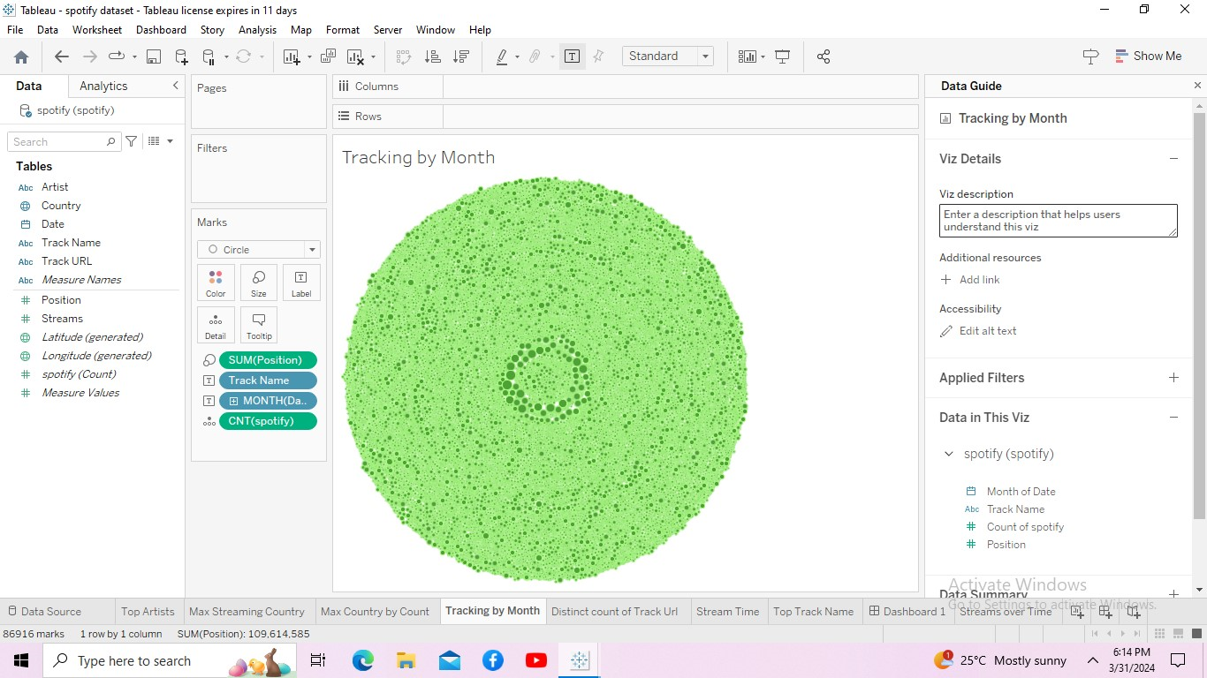
Tracking the most Played songs by Month In this by analyzing the total track name by month in date , Sum of Streaming, I used bubble filter to show this visualize.

Slide 8
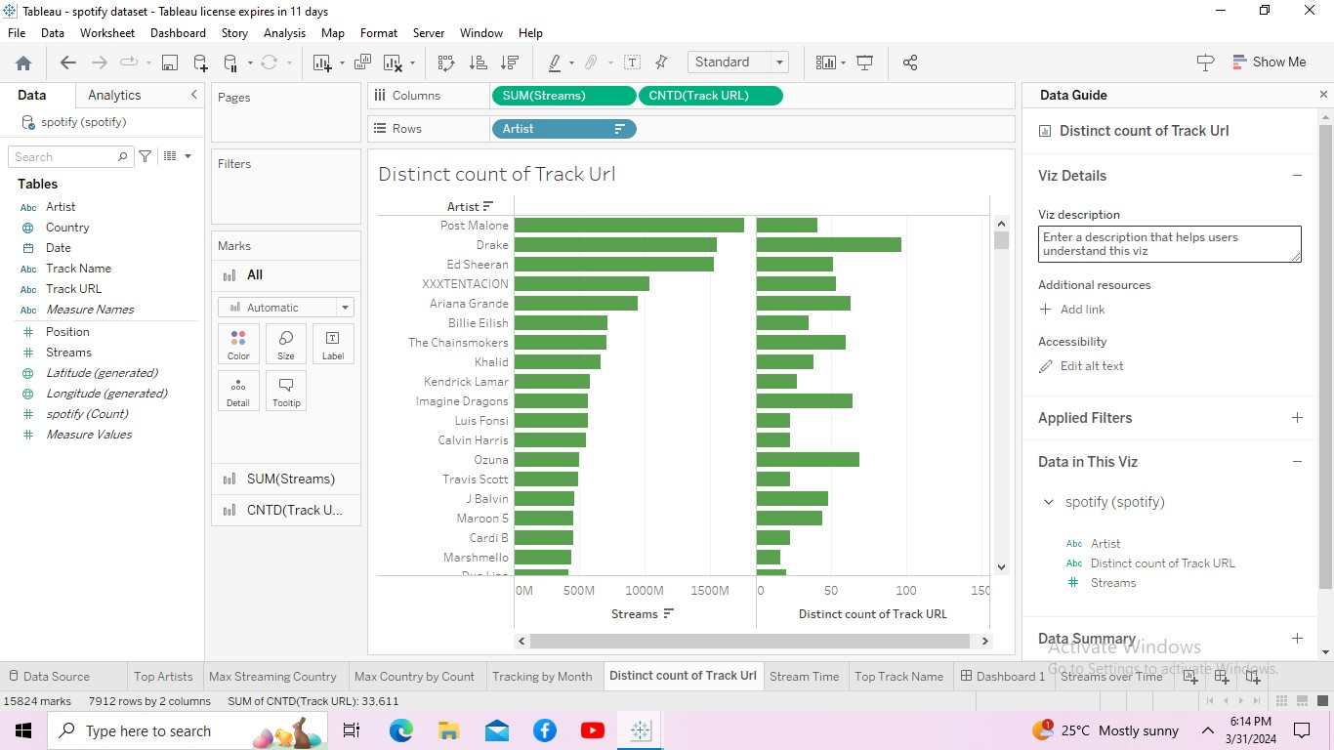
Most popular tracks and artists In this by analyzing the most popular tracks in Spotify’s Top 200 list. By using the Track URL field as a unique identifier when we’re doing distinct counts of tracks since some songs may be named the same thing. Drag Track URL to Columns. Change the Measure to Count (Distinct). We quickly see that there are over 50,000 tracks within the data set. Drag the Artist field to Rows. Sort from greatest to least to see the artist with the most tracks in the data set. But remember, just because an artist has the most tracks in the list doesn’t mean they have the most streams. We can see this in the screenshot below.

Slide 9
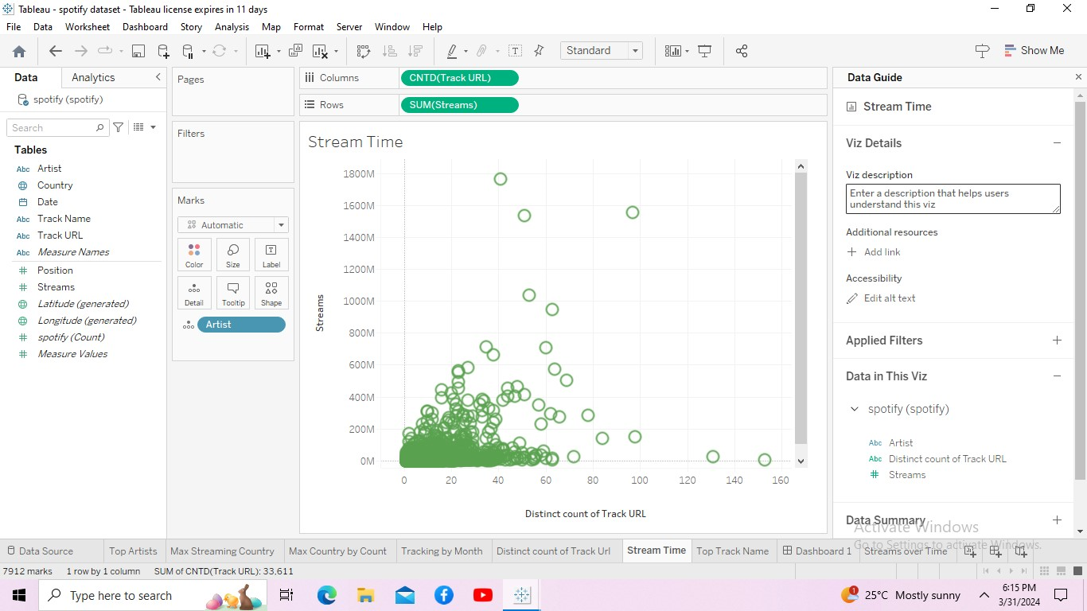
In this slide I prepared a scatterplot view instead. Now we can see that Drake consistently has a lot of tracks in the Top 200 and these tracks get a lot of stream time.

Slide 10
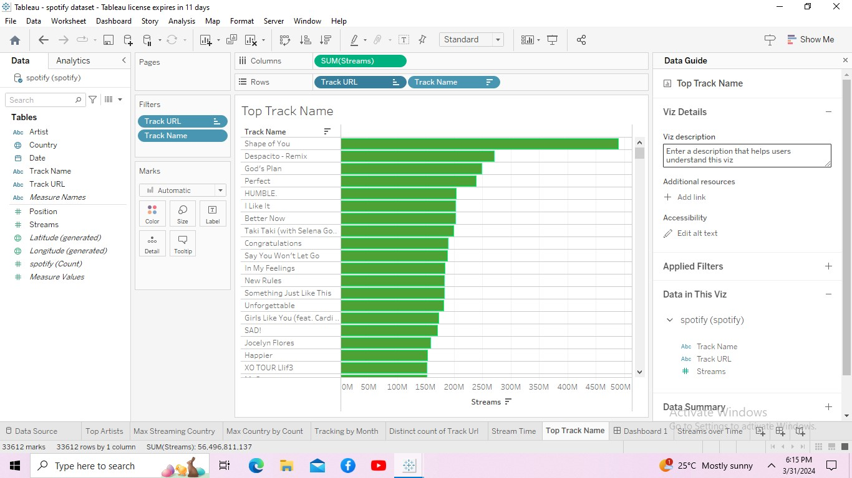
In this I analyzed the most popular and played songs. To list out from top to least. Create a new sheet. Add SUM(Streams) to Columns and Track URL to Rows. Sort greatest to least. Add Track Name next to Track URL on Rows. Hide Track URL header by right clicking on the pill in Rows and deselecting “Show Header.” It looks like Ed Sheeran’s “Shape of You” has over 4 billion streams!

Slide 11
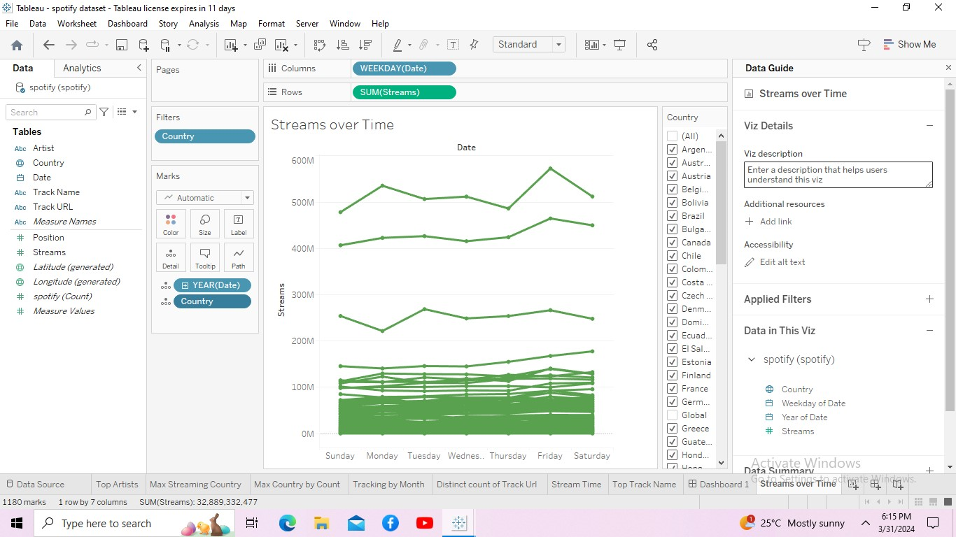
Streaming over time Song Streams over time. We’ll use this later in our dashboard to get a comprehensive view of streams for each song and artist. Add Continuous WEEK(Date) to Columns and SUM(Streams) to Rows. In this I filtered the global from the list.

Slide 12
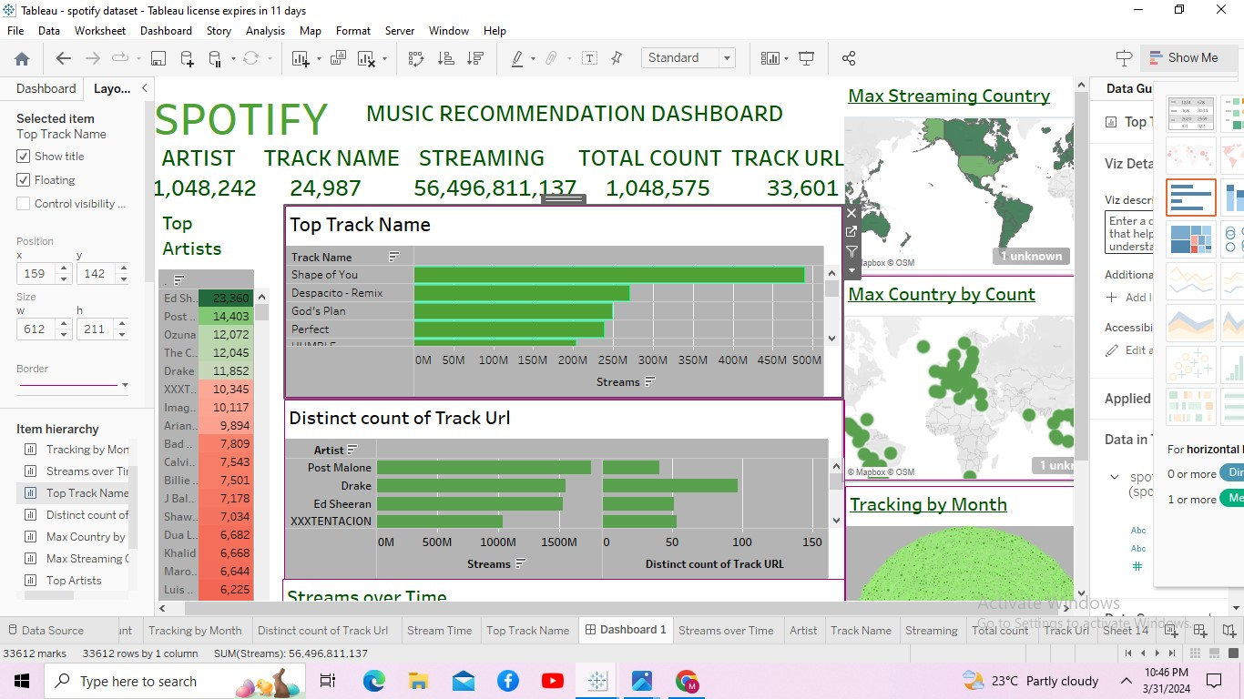
Putting it all together into Dashboard Now we can how this data all relates by putting it into a dashboard by Creating a new dashboard. Drag the sheets we created for our “Most popular artists,” “Most popular tracks,” and “Streams over time” along with our map onto the dashboard. Select Use as Filter on our map as well as our bar charts. By using the total count of artist names and created KPI Finally, I customize the map to be Spotify colors. Select Format→ Dashboard to format colors, grid lines, and more.

